Slide 1


Employee Data Analysis using Excel
STUDENT NAME : PORKODI.V
REGISTER NO: 312216583
DEPARTMENT: B.COM (G)
COLLEGE: R.B.GOTHI JAIN COLLEGE FOR WOMEN
STUDENT NAME:
REGISTER NO:
DEPARTMENT:
COLLEGE

Slide 2
PROJECT TITLE
Employee Performance Analysis using Excel

Slide 3


AGENDA
Problem Statement
Project Overview
End Users
Our Solution and Proposition
Dataset Description
Modelling Approach
Results and Discussion
Conclusion
3/21/2024 Annual Review

Slide 4

PROBLEM STATEMENT
Employees performance analysis Using excel involves Evaluating and measuring an Employees work effectiveness and efficiency based on key performance indicator (kpi). This data is then analysed using excels functions and tools such as pivot tables ,chats, and conditional formatting, to identify patterns ,strengths and areas for improvement.

Slide 5

PROJECT OVERVIEW
.
The project “employee performance analysis Using excel “aims to systemically evaluate employee productivity and effectiveness by leVerage analytics tools .the project will involve collecting and organizing performance data such as task completion rates ,accuracy and records. The final delivery will include a detailed report and virtual.

Slide 6
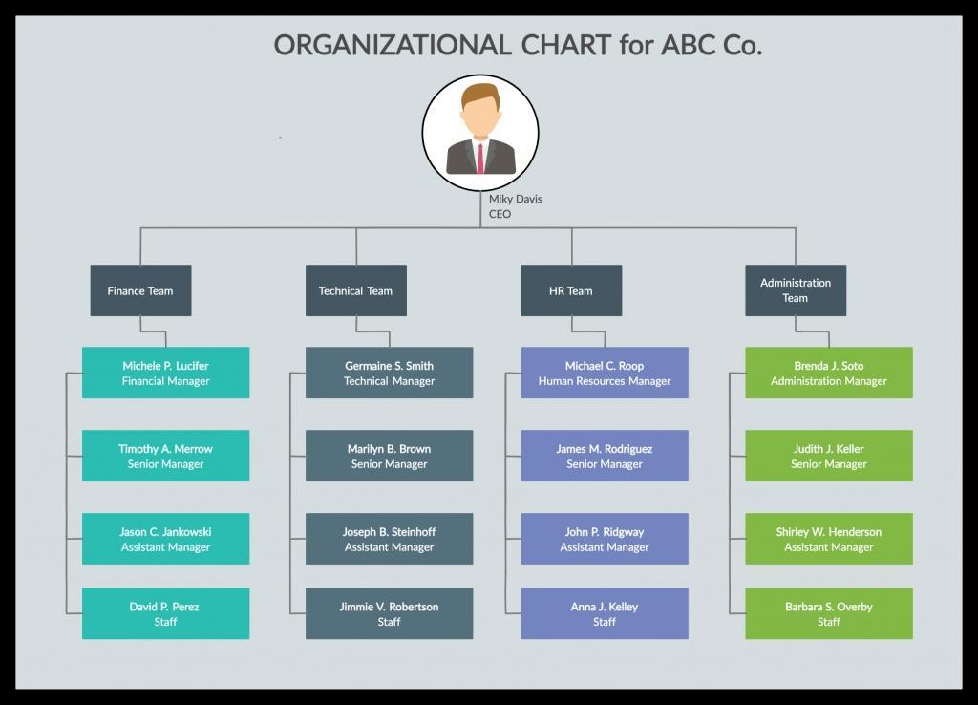

WHO ARE THE END USERS?
Organization
Employee manager
HRM

Slide 7

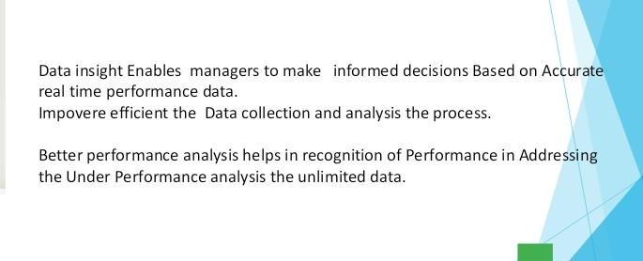
OUR SOLUTION AND ITS VALUE PROPOSITION

Slide 8
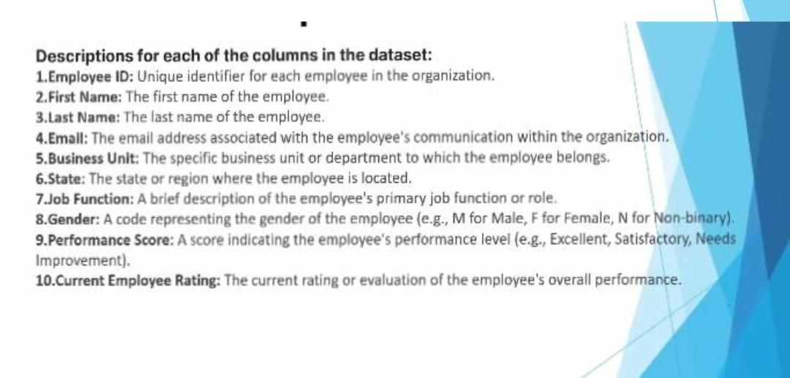
Dataset Description

Slide 9
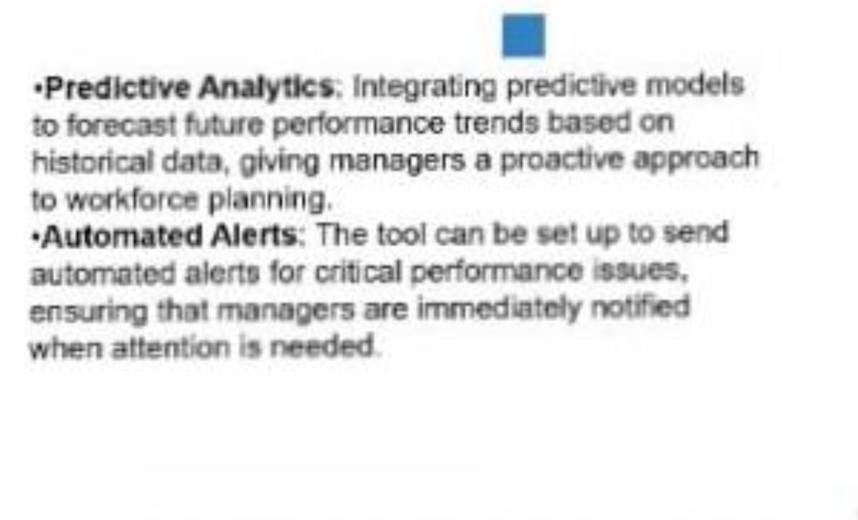

THE "WOW" IN OUR SOLUTION
3/21/2024 Annual Review
‹#›

Slide 10
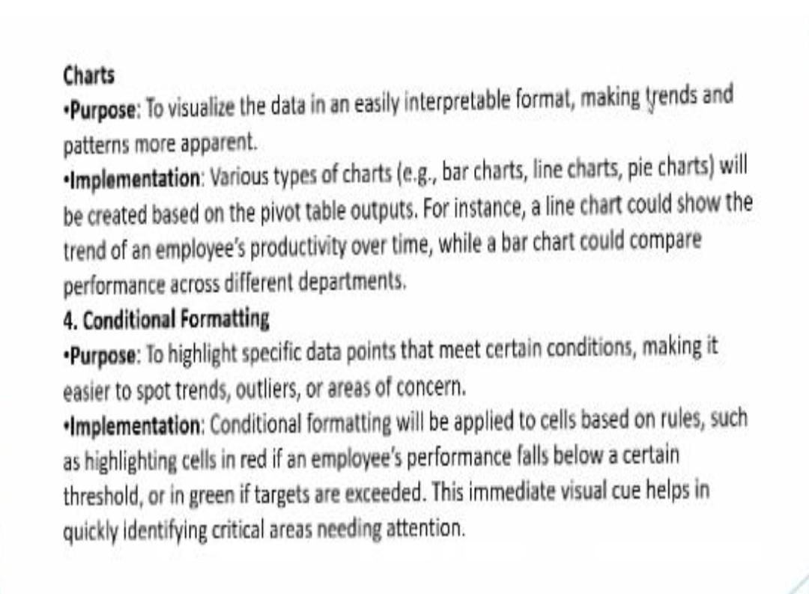
MODELLING
‹#›

Slide 11
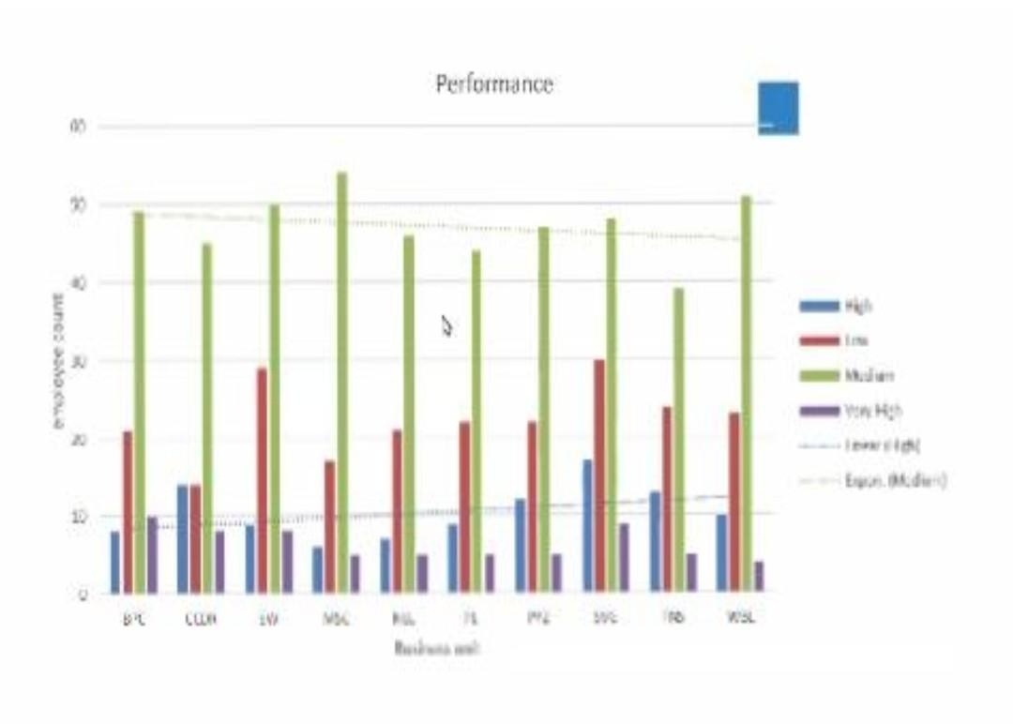
RESULTS
‹#›

Slide 12
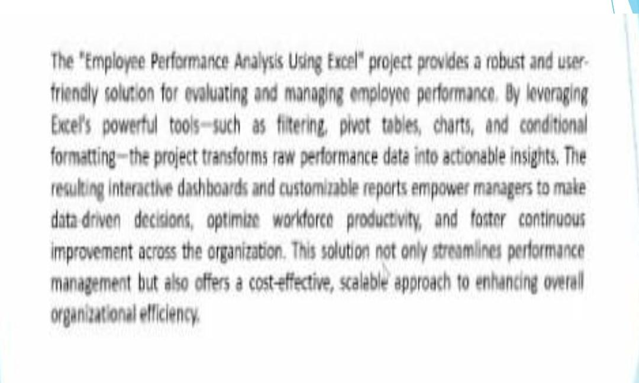
conclusion

